Slide 1

Python Programming Unit 4 (KNC-302)
Prepared By
Abhishek Kesharwani
Assistant Professor,UCER Naini,Allahabad

Slide 2
UNIT IV
Modules: Introduction,
Importing Modules,
Abstract Data Types : Abstract data types and ADT interface in Python Programming.
Classes : Class definition and other operations in the classes
Special Methods ( such as _init_,_str_, comparison methods and Arithmetic methods etc.)
Class Example , Inheritance , Inheritance and OOP.

Slide 3
Python Modules
A python module can be defined as a python program file which contains a python code including python functions, class, or variables. In other words, we can say that our python code file saved with the extension (.py) is treated as the module.
We may have a runnable code inside the python module.
Modules in Python provides us the flexibility to organize the code in a logical way.
To use the functionality of one module into another, we must have to import the specific module.

Slide 4
Loading the module in our python code
Python provides two types of statements as defined below.
The import statement
The from-import statement

Slide 5
The import statement
The import statement is used to import all the functionality of one module into another. Here, we must notice that we can use the functionality of any python source file by importing that file as the module into another python source file.
We can import multiple modules with a single import statement, but a module is loaded once regardless of the number of times, it has been imported into our file.

Slide 6
The syntax to use the import statement is given below.
import module1,module2,........ module n
Let's create the module named as file.py.
#displayMsg prints a message to the name being passed.
def displayMsg(name)
print("Hi "+name);

Slide 7
import file;
name = input("Enter the name?")
file.displayMsg(name)
Output:
Enter the name John
Hi John

Slide 8
The from-import statement
Instead of importing the whole module into the namespace, python provides the flexibility to import only the specific attributes of a module.
This can be done by using from? import statement. The syntax to use the from-import statement is given below.
from < module-name> import <name 1>, <name 2>..,<name n>

Slide 9
calculation.py
def summation(a,b):
return a+b
def multiplication(a,b):
return a*b;
def divide(a,b):
return a/b;

Slide 10
Main.py
from calculation import summation
#it will import only the summation() from calculation.py
a = int(input("Enter the first number"))
b = int(input("Enter the second number"))
print("Sum = ",summation(a,b)) #we do not need to specify the module name while accessing summation()

Slide 11
Output
Enter the first number 10
Enter the second number 20
Sum = 30
NOTE: We can also import all the attributes from a module by using *.
from <module> import *

Slide 12
Renaming a module
Python provides us the flexibility to import some module with a specific name so that we can use this name to use that module in our python source file.
syntax
import <module-name> as <specific-name>

Slide 13
dir() function
The dir() function returns a sorted list of names defined in the passed module.
This list contains all the sub-modules, variables and functions defined in this module.
Example
import json
List = dir(json)
print(List)

Slide 14
Output
['JSONDecoder', 'JSONEncoder', '__all__', '__author__', '__builtins__', '__cached__', '__doc__','__file__', '__loader__', '__name__', '__package__', '__path__', '__spec__', '__version__', '_default_decoder', '_default_encoder', 'decoder', 'dump', 'dumps', 'encoder', 'load', 'loads', 'scanner']

Slide 15
Python OOPs Concepts
Python is an object-oriented programming language.
It allows us to develop applications using an Object Oriented approach.
In Python, we can easily create and use classes and objects.

Slide 16
Major principles of object-oriented programming system are given below.
Object
Class
Method
Inheritance
Polymorphism
Data Abstraction
Encapsulation

Slide 17
Object
The object is an entity that has state and behavior.
It may be any real-world object like the mouse, keyboard, chair, table, pen, etc.
Everything in Python is an object, and almost everything has attributes and methods.
All functions have a built-in attribute __doc__ which returns the doc string defined in the function source code.

Slide 18
Class
It is a logical entity that has some specific attributes and methods.
For example:
if you have an employee class then it should contain an attribute and method, i.e. an email id, name, age, salary, etc.

Slide 19
Method
The method is a function that is associated with an object.
In Python, a method is not unique to class instances.
Any object type can have methods.

Slide 20
Inheritance
Inheritance is the most important aspect of object-oriented programming which simulates the real world concept of inheritance.
It specifies that the child object acquires all the properties and behaviors of the parent object.
By using inheritance, we can create a class which uses all the properties and behavior of another class.

Slide 21
The new class is known as a derived class or child class, and the one whose properties are acquired is known as a base class or parent class.
It provides re-usability of the code.

Slide 22
Polymorphism
Polymorphism contains two words "poly" and "morphs". Poly means many and Morphs means form, shape.
By polymorphism, we understand that one task can be performed in different ways.

Slide 23
Encapsulation
Encapsulation is also an important aspect of object-oriented programming.
It is used to restrict access to methods and variables.
In encapsulation, code and data are wrapped together within a single unit from being modified by accident.

Slide 24
Data Abstraction
Data abstraction and encapsulation both are often used as synonyms.
Both are nearly synonym because data abstraction is achieved through encapsulation.
Abstraction is used to hide internal details and show only functionalities.
Abstracting something means to give names to things so that the name captures the core of what a function or a whole program does.

Slide 25
Creating classes in python
In python, a class can be created by using the keyword class followed by the class name.
Syntax
class ClassName:
#statement_suite
A class contains a statement suite including fields, constructor, function, etc. definition.

Slide 26
Example
class Employee:
id = 10;
name = "ayush"
def display (self):
print(self.id,self.name)
NOTE: self is used as a reference variable which refers to the current class object. It is always the first argument in the function definition

Slide 27
Creating an instance of the class
A class needs to be instantiated if we want to use the class attributes in another class or method.
A class can be instantiated by calling the class using the class name.

Slide 28
Example
class Employee:
id = 10;
name = "John"
def display (self):
print("ID: %d \nName: %s"%(self.id,self.name))
emp = Employee()
emp.display()

Slide 29
Output
ID: 10
Name: ayush

Slide 30
Python Constructor
A constructor is a special type of method (function) which is used to initialize the instance members of the class.
Constructors can be of two types.
Parameterized Constructor
Non-parameterized Constructor

Slide 31
Creating the constructor in python
Constructor definition is executed when we create the object of this class.
Constructors also verify that there are enough resources for the object to perform any start-up task.
__init__ simulates the constructor of the class. This method is called when the class is instantiated.
It is mostly used to initialize the class attributes.
Every class must have a constructor, even if it simply relies on the default constructor.

Slide 32
Example
class Employee:
def __init__(self,name,id):
self.id = id;
self.name = name;
def display (self):
print("ID: %d \nName: %s"%(self.id,self.name))
emp1 = Employee("John",101)
emp2 = Employee("David",102)
emp1.display();
emp2.display();

Slide 33
Output
ID: 101
Name: John
ID: 102
Name: David

Slide 34
Python Non-Parameterized Constructor
class Student:
def __init__(self):
print("This is non parametrized constructor")
def show(self,name):
print("Hello",name)
st1 = Student()
st1.show("John")

Slide 35
Output
This is non parametrized constructor
Hello John

Slide 36
Parameterized Constructor Example
class Student:
# Constructor - parameterized
def __init__(self, name):
print("This is parametrized constructor")
self.name = name
def show(self):
print("Hello",self.name)
student = Student("John")
student.show()

Slide 37
Output
This is parametrized constructor
Hello John

Slide 38
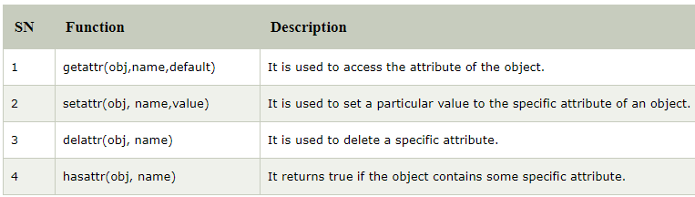
Python In-built class functions

Slide 39
Example
class Student:
def __init__(self,name,id,age):
self.name = name;
self.id = id;
self.age = age
s = Student("John",101,22)
print(getattr(s,'name'))
setattr(s,"age",23)
print(getattr(s,'age'))
print(hasattr(s,'id'))
delattr(s,'age')
print(s.age)

Slide 40
Output
John
23
True
AttributeError: 'Student' object has no attribute 'age'

Slide 41
class Student: def __init__(self,name,roll,marks): self.name=name self.roll=roll self.marks=marks s1=Student("Rahul",1,65) print(getattr(s1,'name')) print(hasattr(s1,'roll')) setattr(s1,'roll',3) print(s1.roll) delattr(s1,'roll') print(s1.roll)

Slide 42
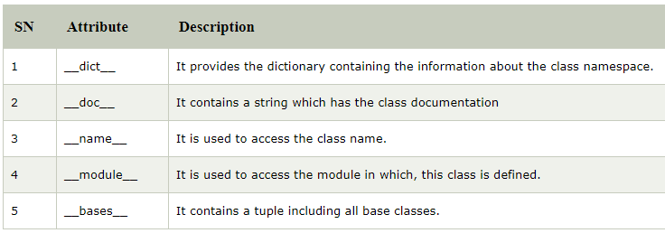
Built-in class attributes

Slide 43
Example
class Student:
def __init__(self,name,id,age):
self.name = name;
self.id = id;
self.age = age
def display_details(self):
print("Name:%s, ID:%d, age:%d"%(self.name,self.id))
s = Student("John",101,22)
print(s.__doc__)
print(s.__dict__)
print(s.__module__)

Slide 44
Output
None
{'name': 'John', 'id': 101, 'age': 22}
__main__

Slide 45
Python Inheritance
Inheritance is an important aspect of the object-oriented paradigm.
Inheritance provides code reusability to the program because we can use an existing class to create a new class instead of creating it from scratch.
In inheritance, the child class acquires the properties and can access all the data members and functions defined in the parent class.

Slide 46
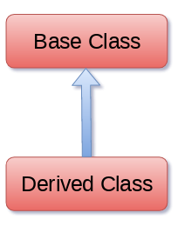
Syntax
class derived-class(base class):
<class-suite>

Slide 47
A class can inherit multiple classes by mentioning all of them inside the bracket.
Syntax
class derive-class
(<base class 1>, <base class 2>, ..... <base class n>):
<class - suite>

Slide 48
Example
class Animal:
def speak(self):
print("Animal Speaking")
#child class Dog inherits the base class Animal
class Dog(Animal):
def bark(self):
print("dog barking")
d = Dog()
d.bark()
d.speak()

Slide 49
Python Multi-Level inheritance
Multi-Level inheritance is possible in python like other object-oriented languages.
Multi-level inheritance is archived when a derived class inherits another derived class.
There is no limit on the number of levels up to which, the multi-level inheritance is archived in python.

Slide 50
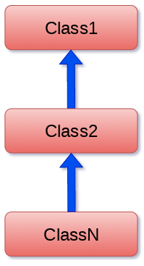
Multi-Level inheritance

Slide 51
Syntax
class class1:
<class-suite>
class class2(class1):
<class suite>
class class3(class2):
<class suite>

Slide 52
Example
class Animal:
def speak(self):
print("Animal Speaking")
#The child class Dog inherits the base class Animal
class Dog(Animal):
def bark(self):
print("dog barking")
#The child class Dogchild inherits another child class Dog
class DogChild(Dog):
def eat(self):
print("Eating bread...")
d = DogChild()
d.bark()
d.speak()
d.eat()

Slide 53
Output
dog barking
Animal Speaking
Eating bread..

Slide 54
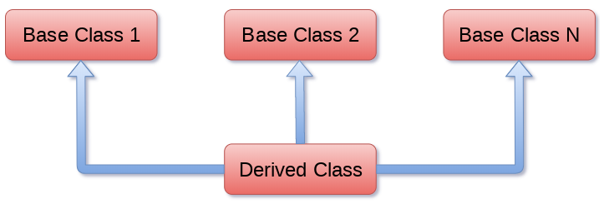
Python Multiple inheritance

Slide 55
Syntax
class Base1:
<class-suite>
class Base2:
<class-suite>
.
.
.
class BaseN:
<class-suite>
class Derived(Base1, Base2, ...... BaseN):
<class-suite>

Slide 56
Example
class Calculation1:
def Summation(self,a,b):
return a+b
class Calculation2:
def Multiplication(self,a,b):
return a*b
class Derived(Calculation1,Calculation2):
def Divide(self,a,b):
return a/b
d = Derived()
print(d.Summation(10,20))
print(d.Multiplication(10,20))
print(d.Divide(10,20))

Slide 57
issubclass(sub,sup) method
The issubclass(sub, sup) method is used to check the relationships between the specified classes.
It returns true if the first class is the subclass of the second class, and false otherwise.

Slide 58
Example
class Calculation1:
def Summation(self,a,b):
return a+b;
class Calculation2:
def Multiplication(self,a,b):
return a*b;
class Derived(Calculation1,Calculation2):
def Divide(self,a,b):
return a/b;
d = Derived()
print(issubclass(Derived,Calculation2))
print(issubclass(Calculation1,Calculation2))

Slide 59
Output
True
False

Slide 60
Method Overriding
When the parent class method is defined in the child class with some specific implementation, then the concept is called method overriding.
We may need to perform method overriding in the scenario where the different definition of a parent class method is needed in the child class.

Slide 61
Example
class Animal:
def speak(self):
print("speaking")
class Dog(Animal):
def speak(self):
print("Barking")
d = Dog()
d.speak()

Slide 62
Output
Barking

Slide 63
Data abstraction in python
Abstraction is an important aspect of object-oriented programming.
In python, we can also perform data hiding by adding the double underscore (___) as a prefix to the attribute which is to be hidden.
After this, the attribute will not be visible outside of the class through the object.

Slide 64
class Employee:
__count = 0;
def __init__(self):
Employee.__count = Employee.__count+1
def display(self):
print("The number of employees",Employee.__count)
emp = Employee()
emp2 = Employee()
try:
print(emp.__count)
finally:
emp.display()

Slide 65
Output
The number of employees 2
AttributeError: 'Employee' object has no attribute '__count'

